Slide 1
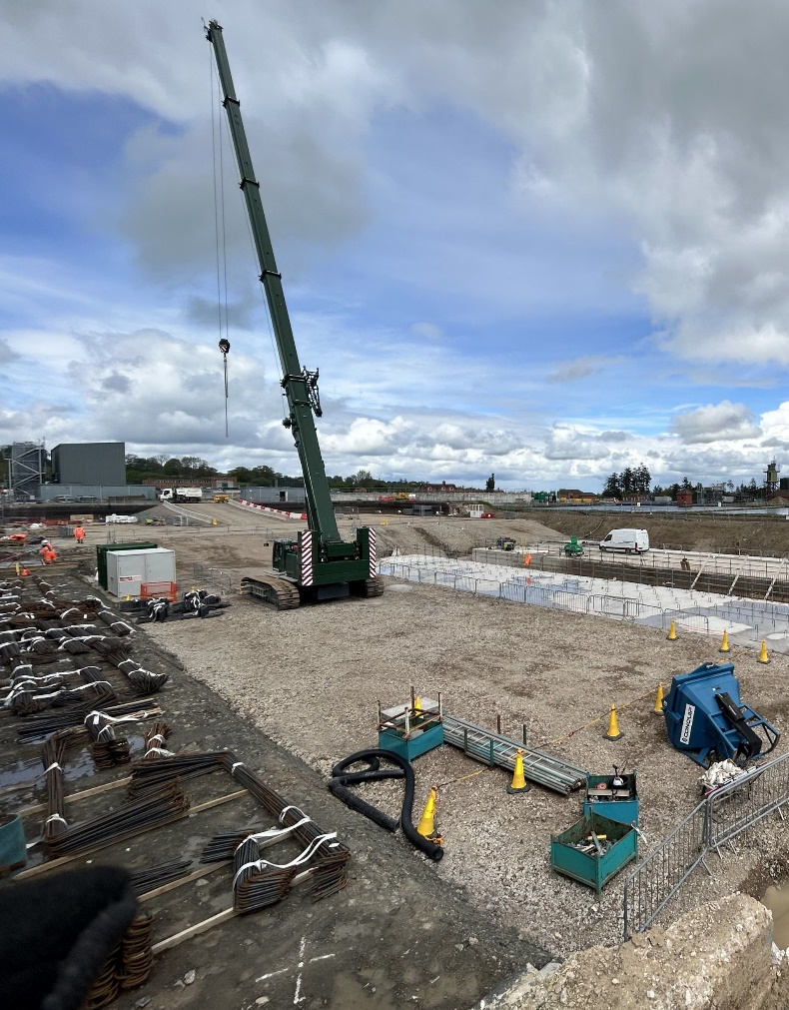
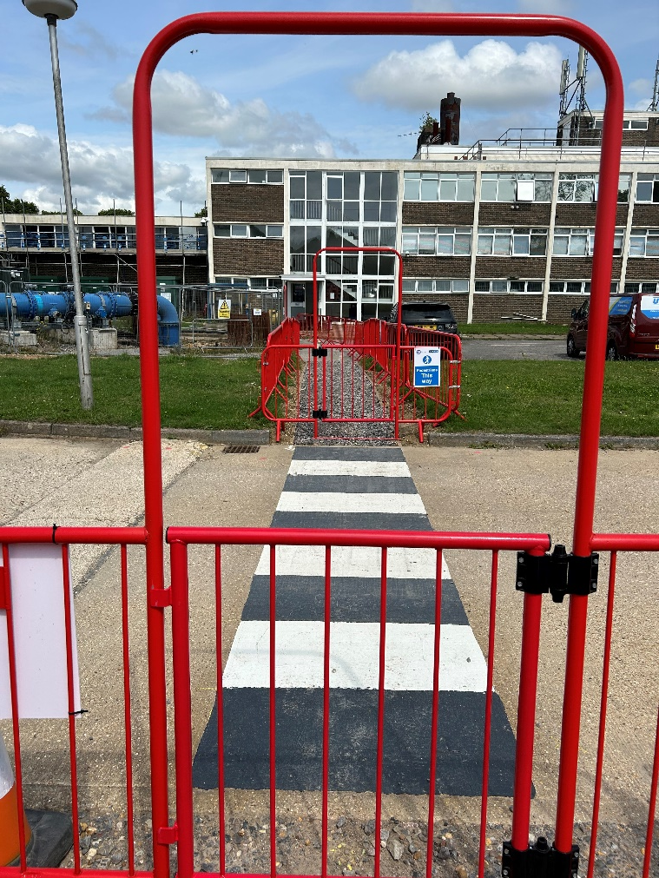

Life Saving Essentials
We care about your Safety
Slips, Trips and Falls
Person
Are you using safe routes?
Are you aware of your environment?
Be mindful of distractions.
Are you fit and well?
Planning
Pedestrian routes planned?
Maintenance provisions in place?
Weather conditions considered?
Equipment/Tools
Fencing available and in good order?
Winter grit stores available?
Footwear in good condition?
Lighting available if required?
Workplace
Walkways level, firm and free from obstacles?
Suitable bins / storage?
High standards of housekeeping?
Uneven surfaces marked / removed?

